Slide 1
Benjamin Rochlin
T1A3 - Portfolio Website

Slide 2
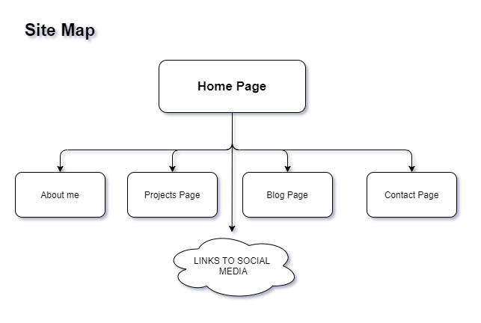
Basic Structure

Slide 3
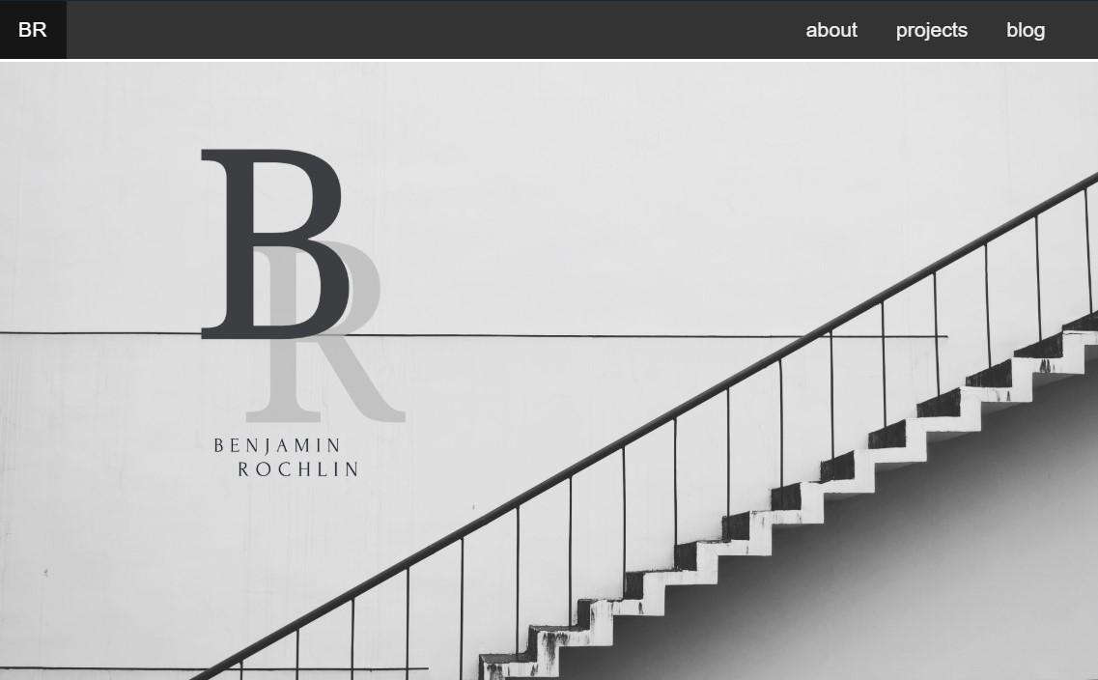
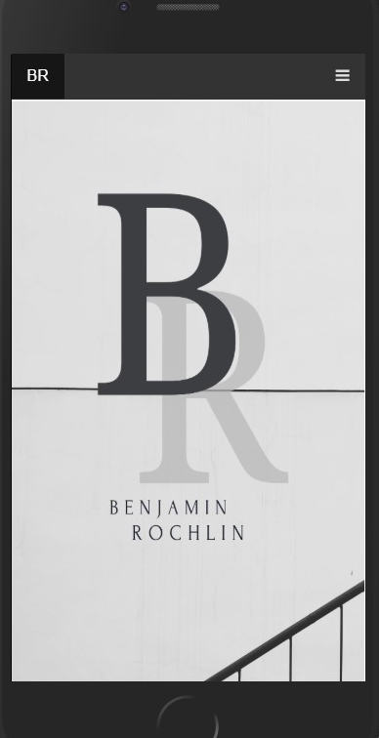
Main Idea
Responsive
Motion design
User experience
Physical Computing

Slide 4



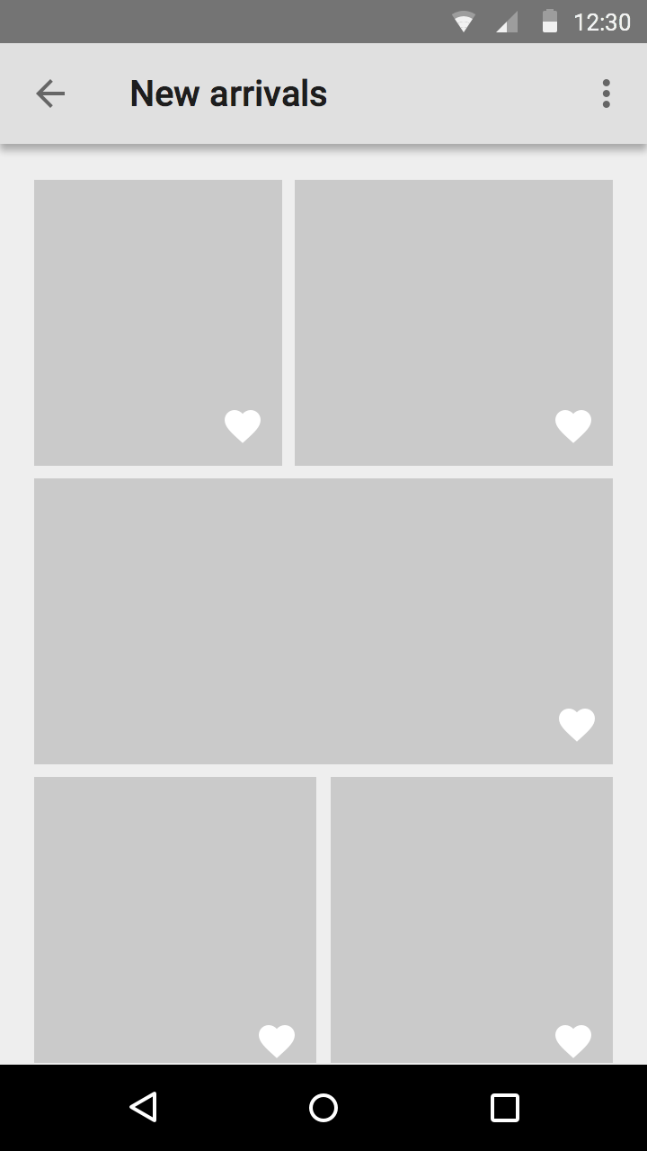
Responsive
Can
Be
Very
difficult
But
Incredibly
Rewarding

Slide 5
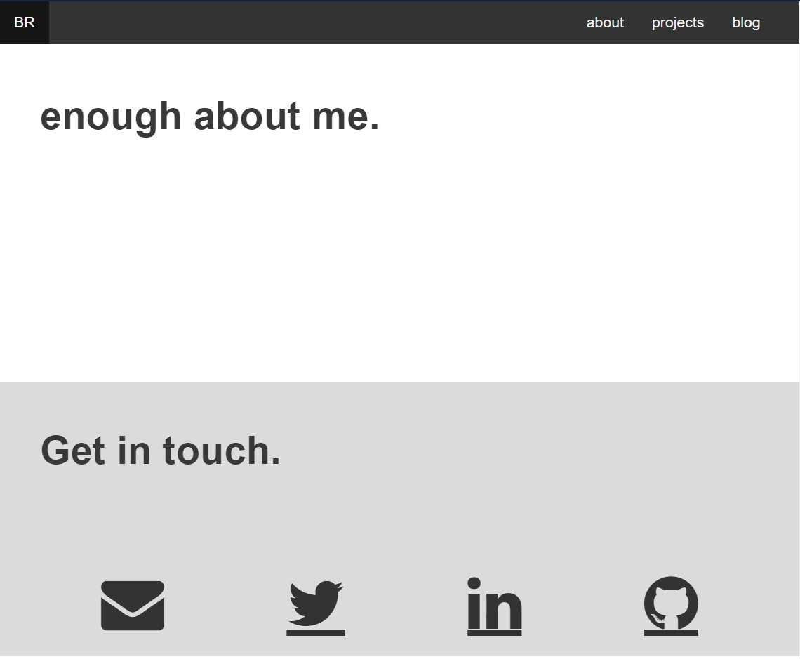
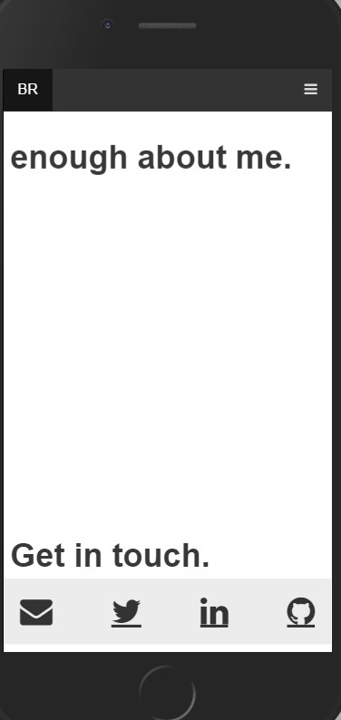

Slide 6
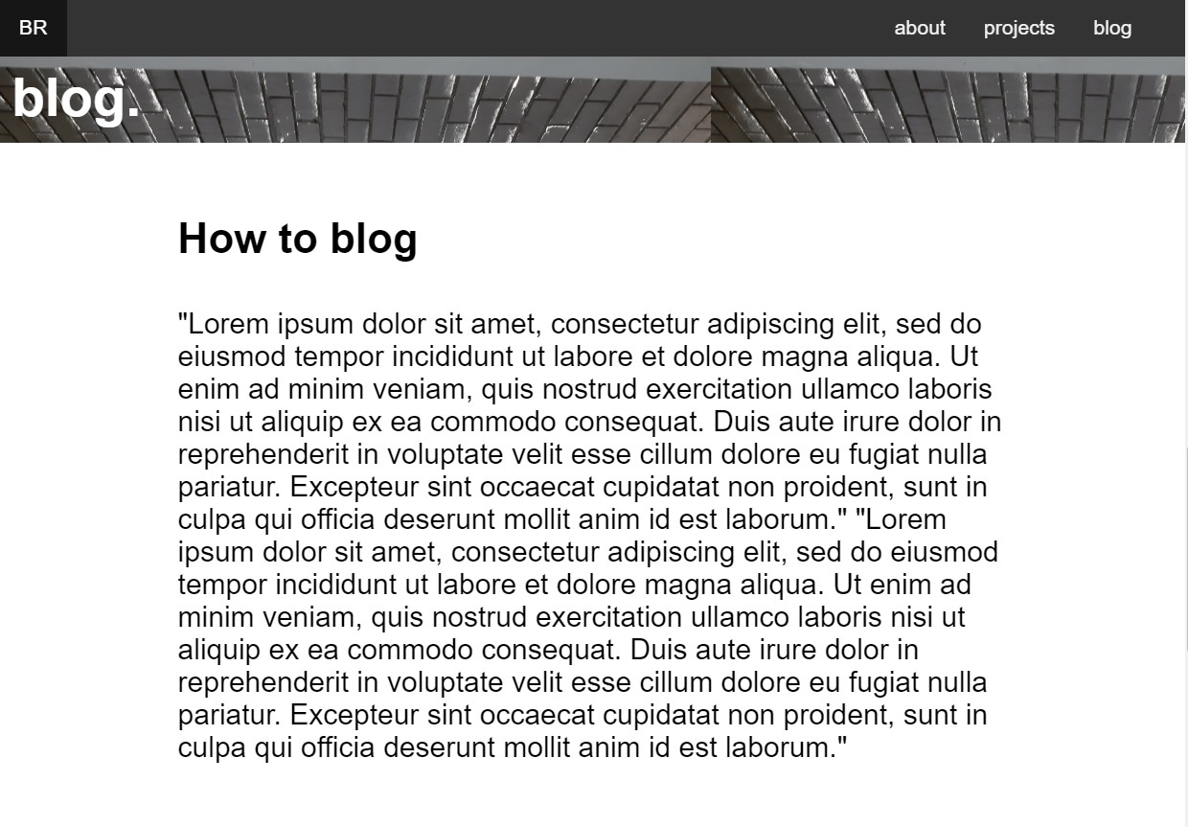
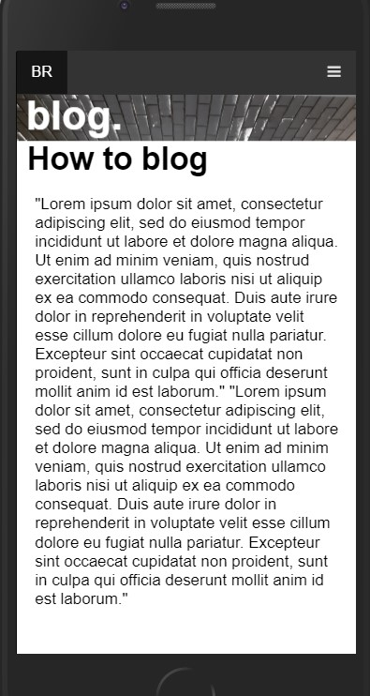

Slide 7
Favourite
Features
Sticky Things
Using minimal colours
Responsive elements

Slide 8
Thank You.

